Slide 1






Trading social status for genetics in marriage markets: Evidence from UK Biobank
Abdel Abdellaoui (Amsterdam UMC) Oana Borcan (UEA) Pierre Chiappori (Columbia) David Hugh-Jones (UEA)
Presentation at Brunel University

Slide 2
Context
Basic thesis of modern behavioural genetics:
Genetic data explains social outcomes.
What’s a social scientist to do?
One answer: find out where the genes come from.
Genetic assortative mating (Hugh-Jones et al. 2016).
Geographic sorting (Abdellaoui et al. 2019).
Natural selection (Hugh-Jones and Abdellaoui 2021, working paper).
This paper.

Slide 3
Goals of this paper
In increasing order of ambition/decreasing order of precision:
Explain a puzzle about the intergenerational persistence of inequality.
Provide a new explanation of the genes-SES gradient.
Rethink the nature of inequality in historical human societies.
Draw the sting of the nature-nurture debate, by changing how we understand genetic variation.

Slide 4
Introduction
Inequality persists over generations. It can be surprisingly persistent over time (Clark and Simmons 2015; Solon 2018).
Families are part of the mechanism, since wealth, human capital and other traits are passed from parents to children.
Inherited human genetics help to explain inequality:
Heritability of occupational class and educational attainment is about 50% (Tambs et al. 1989).
2-year-old children’s family socio-economic status can be predicted from their genes (Trzaskowski et al. 2014).
Polygenic scores for educational attainment predict occupational class (Rimfeld et al. 2018).
The leading explanation for this gene-status gradient is meritocracy. “Good genes” lead to upward mobility.

Slide 5
Introduction
We offer a new explanation for the genes-status gradient, based on assortative mating (Fernandez and Rogerson 2000; Fernandez et al. 2005; Schwartz and Mare 2005; Greenwood et al. 2014; Eika et al. 2019).
Under social-genetic assortative mating (SGAM), social status and “good” genes both contribute to attractiveness in marriage markets.
Both are inherited.
As a result, social status and genetics become associated in the next generation.
Shocks to social status are reflected in children’s genetics.
The gene-status gradient is likely historically widespread.
We test this theory using data from the UK Biobank.

Slide 6
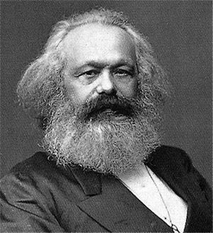
“the effect of ugliness, its repelling power, is destroyed by money.”

Slide 7

“the effect of ugliness, its repelling power, is destroyed by money.”
“Part of the beauty of me is that I am very rich.”

Slide 8
Despite these insights, almost no previous work on social-genetic assortative mating, in genetics, economics or other social sciences.
Halsey (1958) showed in a two-class model that social mobility combined with assortative mating might increase the association between genetics and social class.
“the effect of ugliness, its repelling power, is destroyed by money.”
“Part of the beauty of me is that I am very rich.”

Slide 9
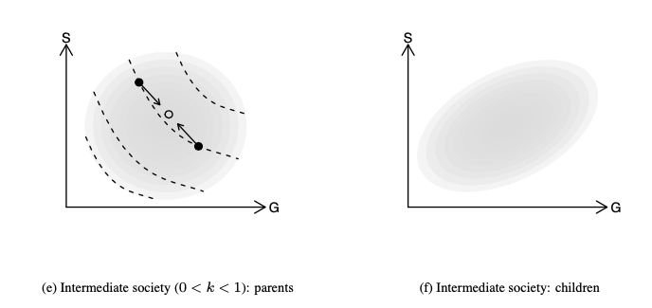
Model

Slide 10

Model
Traits $x_{1}$ (genetic) and $x_{2}$ (SES) are normally distributed in the population.
Attractiveness is $ax_{1}+(1−a)x_{2}$ where $0≤a≤1$ is the relative importance of genes.
People mate assortatively. E.g. transferable surplus which is supermodular in either person’s attractiveness.
Children inherit
$${x′}_{1}=\frac{τ}{2}\left(x_{1}+y_{1}\right)+ε$$
$$x_{2}^{′}=\frac{θ}{2}\left(x_{2}+y_{2}\right)+η$$
Where:
$τ$ is close to 1 (genetic inheritance).
$θ$ reflects persistence of wealth (e.g. tax rate $1−θ$).

Slide 11
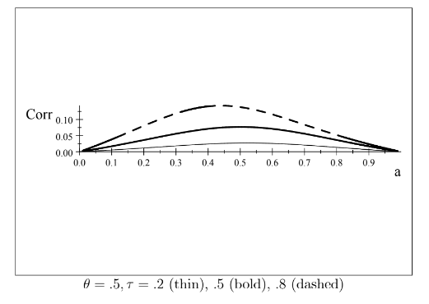

Result
If parents’ $x_{1}$ and $x_{2}$ are independent, children’s $x_{1}$ and $x_{2}$ are positively correlated for $0<a<1$.
Correlation increases then decreases in $a$:

Slide 12

Extensions
In the stationary distribution, $x_{1}$ and $x_{2}$ are positively correlated, again depending on $a$.
We can allow “meritocracy”, where adult SES $x_{2}$ depends on own genes $x_{1}$.
The basic result is robust to non-normal/discontinuous distributions and non-linear attractiveness.
Empirics: regressing grandchildren SES $x_{2}$ on grandparent and parent SES, grandparent SES can have a positive partial correlation.

Slide 13
Data
UK Biobank, a study of about 500,000 individuals born 1935-1970. Contains questionnaire data on health and social characteristics, also DNA data. Non-representative!
We don’t have explicit information on spouse pairs.
We categorize people as pairs if they:
• had the same home postcode
• have the same homeownership/renting status, length of time at the address, and number of children
• attended the same UK Biobank assessment centre on the same day;
• both reported living with their spouse (“husband, wife or partner”);
• consisted of one male and one female.
We validate these pairs using genetic children, also in the database.

Slide 14
Our dependent variable is spouse’s Polygenic Score for Educational Attainment (PSEA).
This is a DNA-derived summary statistic which predicts people’s level of educational attainment.

Slide 15
Polygenic scores – a primer
Individual DNA contains about 3 billion base pairs, on 23 chromosomes. Each base pair can be one of four letters (A, C, T or G). About 0.1% of these pairs will be different between any two individuals.
A Single Nucleotide Polymorphisms (SNPs) is a base pair where individuals’ genomes vary by a single “letter”. Individuals have 0, 1 or 2 copies of the rare allele.
DNA array data records many SNPs of an individual’s genome (in UKBB, about 500,000 SNPs).

Slide 16

Polygenic scores – a primer
Many heritable traits are highly polygenic: the sum of small effects from many loci on the genome.
A polygenic score is estimated using many SNPs. Bivariate correlations are estimated:
$$Trait_{i}=β_{j}SNP_{i,j}+ε_{i}$$
The score is then
$$PGS_{i}=\sum_{j}{β_{j}SNP_{i,j}}$$
Intuition: a PGS is like a regression $\hat{y}$ , but with “naively” estimated $β$s.
$β_{j}$ may be corrected for correlation by various methods.

Slide 17
Polygenic Score for Educational Attainment
Linear regression of probability of attending university on PSEA: 1 sd PSEA = 9.2 percentage points.
Within-siblings regression: 4.5 percentage points.
Within-family regressions guarantee causality by the “lottery of meiosis”.
Substantial confounding with environment, but large causal effects.
We know that humans mate assortatively on education and on PSEA – effects are stronger than for any other PGS.
University attendance by PSEA decile

Slide 18
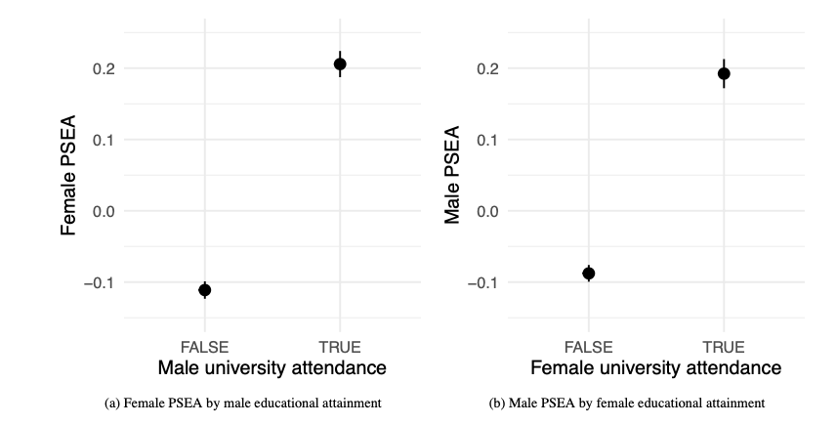

Slide 19
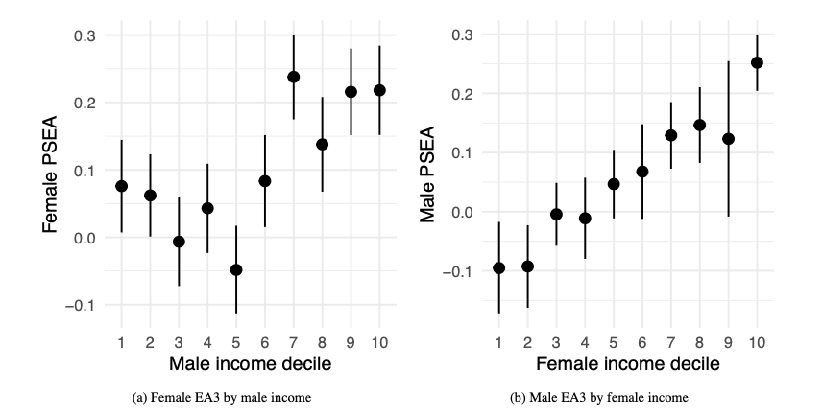

Slide 20
These results could be confounded by the individual’s own genetics.
We already know that there is assortative mating on PSEA (Hugh-Jones et al. 2016).
To avoid this, we need an independent variable which is
independent of genetics;
available for a large enough N.
Large N is needed because polygenic scores and causes of variation in SES are noisy; and the spouse matching process is unpredictable & has discontinuous dynamics (Shakespeare 1595).
We use birth order.
Siblings have the same expected polygenic scores, by the “lottery of meiosis”.
Early-born siblings receive more parental care and have better life outcomes including socio-economic status (SES: Lindahl 2008; Booth and Kee 2009; Black, Devereux, and Salvanes 2011).

Slide 21
Estimation strategy
Hard to justify instrumental variables:
Birth order affects other things than SES.
We only have imperfect measures of SES (rough household income, job, educational attainment).
Instead we run a mediation analysis:
Does birth order affect spouse’s PSEA?
Is the effect mediated by measures of SES?

Slide 22
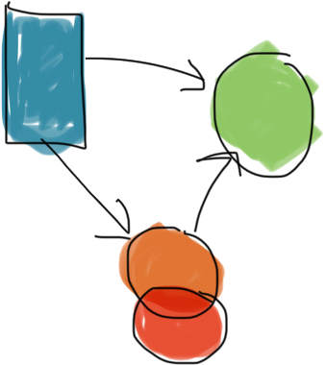
Estimation strategy
Hard to justify instrumental variables:
Birth order affects other things than SES.
We only have imperfect measures of SES (rough household income, job, educational attainment).
Instead we run a mediation analysis:
Does birth order affect spouse’s PSEA?
Is the effect mediated by measures of SES?
Birth order
Spouse
PSEA
SES
Mediators
Other

Slide 23
Controls and mediators
SES mediators
University attendance
Median earnings of first job (guesstimated from 2000 SOC code)
Non-SES mediators
Fluid IQ
Height
Controls
Family size
Month of birth
Year of birth
Parent’s age at birth (correlates with birth order! Only available for some respondents)

Slide 24
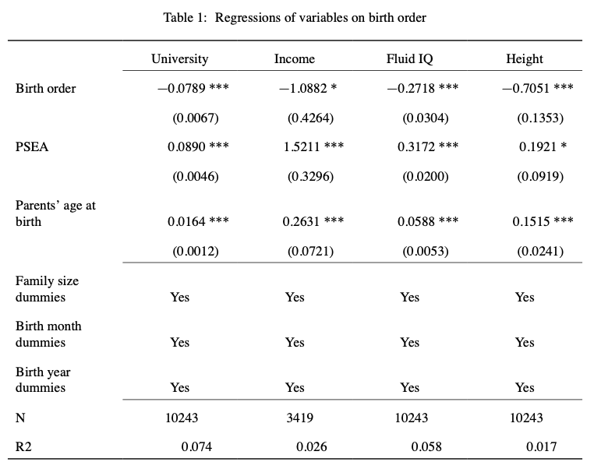

Slide 25
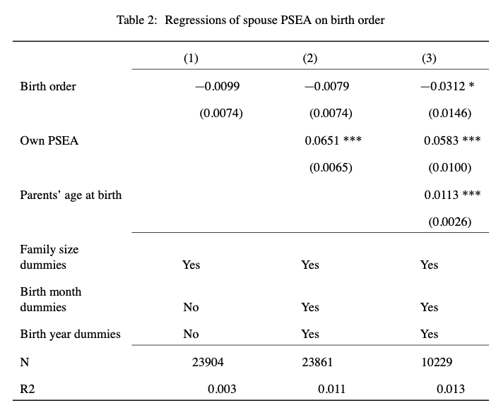

Slide 26
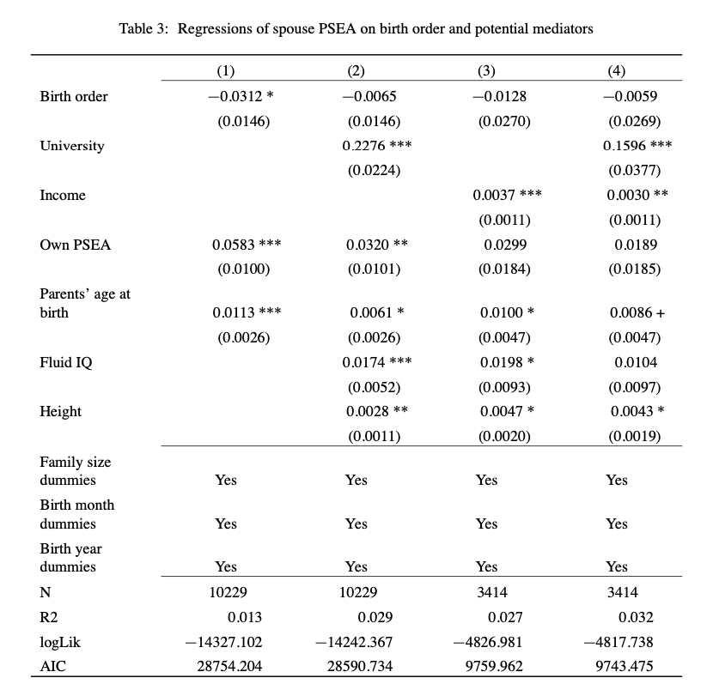
SES mediators
Non-SES mediators, controls

Slide 27
SES mediators
Non-SES mediators, controls

Slide 28
SES mediators
Non-SES mediators, controls

Slide 29
SES mediators
Non-SES mediators, controls

Slide 30
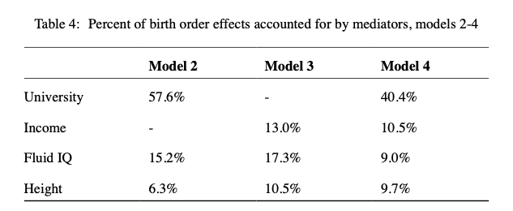

Slide 31
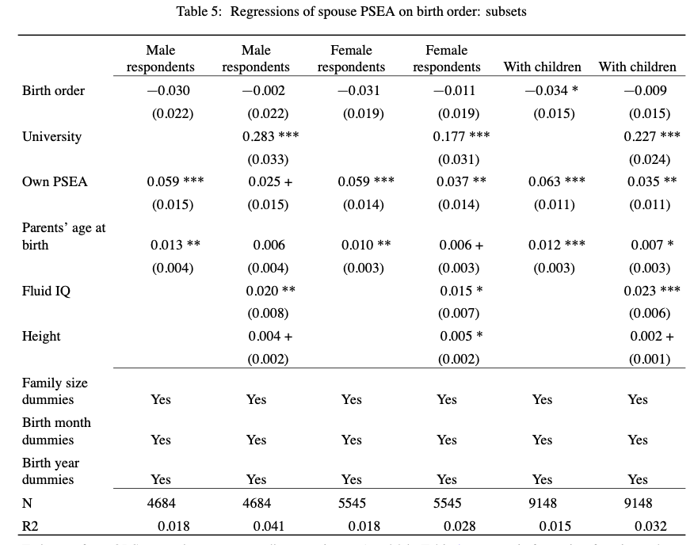

Slide 34
Goals again
Explain a puzzle about the intergenerational persistence of inequality.
Clark (2021): grandparental wealth predicts grandchild wealth, even controlling for parental wealth.
He argues this is due to unmeasured genetic variation.
The same feature arises in our model. But genetic variation is interpreted differently: not exogenous, but traded for wealth and SES in marriage markets.

Slide 35
Goals again
Provide a new explanation of the genes-SES gradient.
In meritocratic societies, genes cause SES.
Under SGAM, in all societies, SES can lead to genetic variation in your descendants. (And vice versa.)
Environmental shocks are reflected in the DNA of subsequent generations.

Slide 36
Goals again
Rethink the nature of inequality in historical human societies.
That “the rich are different” is widely recognized across stratified human societies.
Greeks: elite are καλοί κἀγαθοί (“fine and good”).
Romans: optimates (“best”).
This is typically attributed to ideology (e.g. Gramsci 1973) or psychology (e.g. Furnham 1993).
It may be simply a recognition of reality, of the same order as “the rich have more money”.
Prediction: a genes-status gradient should be visible in ancient DNA.

Slide 37
Goals again
Draw the sting of the nature-nurture debate, by changing how we understand genetic variation.
The media – and scientists – often oppose “nature” (genes) to “nurture”.
Indeed, genetic variation is fixed at conception, and is biological in its effects: genes create proteins, which affect how the body develops, which affect how you interact with your environment, which explains social outcomes.
But genetic variation is a social outcome.
Indeed, genetic variants are assets, which are competed for in marriage markets and other arenas.

Slide 38
Thanks!

Slide 39
Spouse pairs
Some respondents in the Biobank sample have a genetic child who is also in the sample.
Among our spouse pairs, 511 have a genetic child of at least one partner in the sample.
For 86% (441) of these, the child is the genetic child of both partners.
Comparison: 11% of families with dependent children included a stepchild in England and Wales in 2011 (National Statistics 2014).

Slide 40
Bibliography
Halsey, AH. 1958. “Genetics, Social Structure and Intelligence.” British Journal of Sociology 9 (1): 15–28.
Hugh-Jones, David, Karin JH Verweij, Beate St Pourcain, and Abdel Abdellaoui. 2016. “Assortative Mating on Educational Attainment Leads to Genetic Spousal Resemblance for Polygenic Scores.” Intelligence 59: 103–8.
Hugh-Jones, David and Abdel Abdellaoui. 2022. “Human capital mediates natural selection in contemporary humans “. Working paper.
Lindahl, Lena. 2008. “Do Birth Order and Family Size Matter for Intergenerational Income Mobility? Evidence from Sweden.” Applied Economics 40 (17): 2239–57.
National Statistics. 2014. “Stepfamilies in 2011.” https://webarchive.nationalarchives.gov.uk/20160105222243/http:// www.ons.gov.uk/ons/rel/family-demography/stepfamilies/2011/stepfamilies-rpt.html.
Rimfeld, Kaili, Eva Krapohl, Maciej Trzaskowski, Jonathan R. I. Coleman, Saskia Selzam, Philip S. Dale, Tonu Esko, Andres Metspalu, and Robert Plomin. 2018. “Genetic Influence on Social Outcomes During and After the Soviet Era in Estonia.” Nature Human Behaviour 2 (4): 269–75.
Schwartz, Christine R, and Robert D Mare. 2005. “Trends in Educational Assortative Marriage from 1940 to 2003.” Demography 42 (4): 621–46.
Shakespeare, William. 1595. A Midsummer Night’s Dream.
Solon, Gary. 2018. “What Do We Know so Far about Multigenerational Mobility?” The Economic Journal 128 (612): F340–52.
Tambs, Kristian, Jon Martin Sundet, Per Magnus, and K re Berg. 1989. “Genetic and Environmental Contributions to the Covariance Between Occupational Status, Educational Attainment, and IQ: A Study of Twins.” Behavior Genetics 19 (2): 209–22.
Trzaskowski, Maciej, Nicole Harlaar, Rosalind Arden, Eva Krapohl, Kaili Rimfeld, Andrew McMillan, Philip S. Dale, and Robert Plomin. 2014. “Genetic Influence on Family Socioeconomic Status and Childrens Intelligence.” Intelligence 42 (January): 83–88
Abdellaoui, Abdel, David Hugh-Jones, Löıc Yengo, Kathryn E Kemper, Michel G Nivard, Laura Veul, Yan Holtz, et al. 2019. “Genetic Correlates of Social Stratification in Great Britain.” Nature Human Behaviour 3 (12): 1332–42.
Black, Sandra E, Paul J Devereux, and Kjell G Salvanes. 2011. “Older and Wiser? Birth Order and IQ of Young Men.” CESifo Economic Studies 57 (1): 103–20.
Booth, Alison L, and Hiau Joo Kee. 2009. “Birth Order Matters: The Effect of Family Size and Birth Order on Educational Attainment.” Journal of Population Economics 22 (2): 367–97.
Clark, Gregory. 2021. “For Whom the Bell Curve Tolls: A Lineage of 400,000 English Individuals 1750-2020 Shows Genetics Determines Most Social Outcomes.” Working Paper. http://faculty.econ.ucdavis.edu/faculty/ gclark/ClarkGlasgow2021.pdf.
Clark, Gregory, and Neil Cummins. 2015. “Intergenerational Wealth Mobility in England, 1858–2012: Surnames and Social Mobility.” The Economic Journal 125 (582): 61–85.
Eika, Lasse, Magne Mogstad, and Basit Zafar. 2019. “Educational Assortative Mating and Household Income In- equality.” Journal of Political Economy 127 (6): 2795–835.
Fernandez, Raquel, Nezih Guner, and John Knowles. 2005. “Love and Money: A Theoretical and Empirical Analysis of Household Sorting and Inequality.” Quarterly Journal of Economics 120 (1): 273–344.
Fernández, Raquel, and Richard Rogerson. 2001. “Sorting and Long-Run Inequality.” Quarterly Journal of Economics 116 (4): 1305–41.
Furnham, Adrian. 1993. “Just World Beliefs in Twelve Societies.” Journal of Social Psychology 133 (3): 317–29.
Gramsci, Antonio. 1971. Selections from the Prison Notebooks. Lawrence; Wishart London.
Greenwood, Jeremy, Nezih Guner, Georgi Kocharkov, and Cezar Santos. 2014. “Marry Your Like: Assortative Mating and Income Inequality.” American Economic Review 104 (5): 348–53.

